Slide 1

UNIT 8 · MINING COMPLEX TYPES OF DATA · TOPIC 8.7
Web Mining
Discovering knowledge from the Web — content, structure, and usage
Web Content Mining
Web Structure Mining
Web Usage Mining
Presented by Sadikshya Chhetri
Data Mining and Warehousing | Pokhara University | BCA 6th Semester

Slide 2
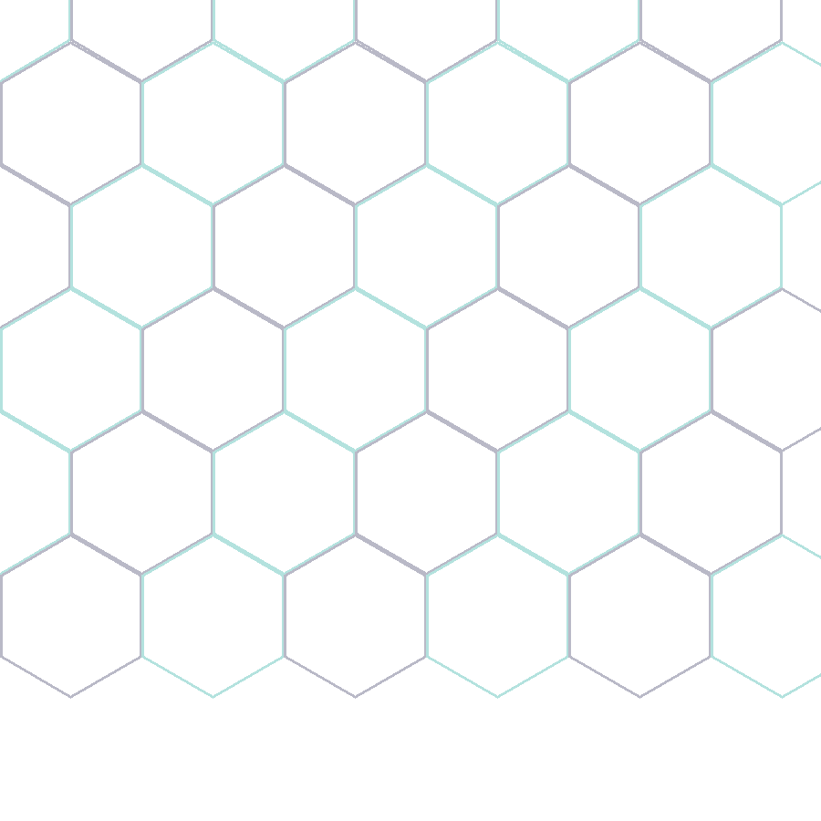
8.7 WEB MINING
What is Web Mining?
Web Mining is the application of data mining techniques to discover patterns, structures, and knowledge from Web data. It treats the World Wide Web — pages, hyperlinks, and user interactions — as a massive, semi-structured data source.
WHY THE WEB IS DIFFERENT
●
Huge & growing
Billions of pages added and updated continuously.
■
Heterogeneous
Text, images, video, scripts, and semi-structured HTML.
GOAL
Turn raw Web data into actionable knowledge for search, personalization, and business intelligence — by combining ideas from data mining, information retrieval, natural language processing, and databases.
◆
Linked
Hyperlinks connect pages into a giant, navigable graph.
▲
Dynamic
Content and user behavior change in real time.
Sadikshya Chhetri
02

Slide 3
WHERE THIS FITS
Web Mining in Unit 8: Mining Complex Types of Data
Unit 8 moves beyond structured tables into complex data types. Web Mining (8.7) is the final and broadest topic — it builds directly on text mining and NLP, then adds the Web's unique structure of hyperlinks and user activity.
→
→
→
→
→
→
8.1
8.2
8.3
8.4
8.5
8.6
8.7
Spatial Data
Mining
Multimedia Data
Mining
Similarity
Search
Multimedia
Associations
Text
Mining
NLP & Info
Extraction
Web
Mining
KEY LINK
Web Content Mining reuses Text Mining (8.5) and NLP (8.6) techniques on page text — Web Mining is best understood as applying everything learned earlier in Unit 8 to a single, richly linked data source: the Web.
Sadikshya Chhetri
03

Slide 4
THE THREE PILLARS
Three Categories of Web Mining
Every Web Mining technique falls into one of three categories, based on what part of the Web it mines.
●
◇
▲
Web Content Mining
Web Structure Mining
Web Usage Mining
The information within pages
The hyperlink graph
Visitor behavior logs
Extracts knowledge from the text, images, and other content on Web pages — what the page says.
Analyzes the link structure connecting pages — who links to whom, and how the Web is organized.
Discovers patterns from server logs and clickstreams — what users do once they arrive.
Sadikshya Chhetri
04

Slide 5
8.7.1
Web Content Mining
The process of extracting useful information and knowledge from the content of Web pages — text, images, audio, video, and structured data such as tables and product listings.
Agent-Based Approach
Database Approach
Intelligent software agents search and filter Web information automatically on the user's behalf.
Treats the Web as a database — modeling semi-structured page data so it can be queried like structured records.
Intelligent search agents
Information filtering / categorization
Personalized Web agents
Uses OEM (Object Exchange Model)
Multilevel databases from raw HTML
Query languages for Web data (e.g. WebSQL)
Example: A search engine scanning a product page to identify its title, price, and category — even though no formal database schema exists.
Sadikshya Chhetri
05

Slide 6
8.7.2
Web Structure Mining
Discovers knowledge from the topology of hyperlinks — treating the Web as a directed graph where pages are nodes and hyperlinks are edges — to reveal authority, structure, and community.
A SIMPLE LINK GRAPH
A
PageRank
Ranks a page by the quantity and quality of pages linking to it. Google's foundational ranking algorithm.
B
C
HITS Algorithm
D
E
Identifies two roles: Hubs (link to many good pages) and Authorities (linked to by many good hubs).
Node A receives the most inbound links → highest authority score
Sadikshya Chhetri
06

Slide 7
8.7.3
Web Usage Mining
Applies data mining to Web server logs, clickstreams, and session data to understand how visitors actually navigate and interact with a site.
→
→
1
Preprocessing
2
Pattern Discovery
3
Pattern Analysis
Clean raw server logs; identify users, sessions, and page views from timestamps and IPs.
Apply association rules, sequential patterns, clustering, and classification to session data.
Filter and interpret discovered patterns to produce usable, actionable insight.
COMMON APPLICATIONS
✓ Personalized recommendations
✓ Targeted marketing & ad placement
✓ Website design & navigation improvement
✓ Fraud & anomaly detection
Sadikshya Chhetri
07

Slide 8
SIDE BY SIDE
Comparing the Three Types
 | Content Mining | Structure Mining | Usage Mining
Data Source | Page text, images, media | Hyperlink topology | Server logs, clickstreams
Views the Web as a... | Document collection | Directed graph | Sequence of user sessions
Key Techniques | NLP, text mining, IR | PageRank, HITS | Association rules, clustering
Typical Output | Topics, summaries, entities | Authoritative pages, communities | Navigation patterns, user profiles
Example Use | Search result relevance | Google's page ranking | Amazon's “customers also viewed”
Sadikshya Chhetri
08

Slide 9
UNDER THE HOOD
Core Techniques & Algorithms Used
◉
◆
▣
Classification & Clustering
Link Analysis (PageRank / HITS)
Association Rule Mining
Groups pages or users by similarity; classifies content into topics or categories.
Scores pages by inbound/outbound link patterns to estimate importance.
Finds items or pages frequently accessed together (market-basket style rules).
▸
≡
◇
Sequential Pattern Mining
NLP & Text Mining
Wrapper Induction
Detects ordered browsing paths — what pages tend to be visited in sequence.
Extracts entities, topics, and sentiment from unstructured page content.
Automatically learns extraction rules to pull structured data from semi-structured HTML.
Sadikshya Chhetri
09

Slide 10
REAL-WORLD IMPACT
Applications of Web Mining
⚶
$
★
Search Engines
E-Commerce
Personalization
Google, Bing rank billions of pages using structure + content mining.
Amazon's recommendations rely on usage-mined behavior patterns.
News feeds and streaming services tailor content to user history.
!
▤
◇
Fraud Detection
Business Intelligence
Competitive Analysis
Unusual click/session patterns flag bots and fraudulent activity.
Companies analyze site traffic to improve UX and conversion.
Tracking competitor content and link strategies (SEO).
Sadikshya Chhetri
10

Slide 11
THE HARD PARTS
Challenges & Issues in Web Mining
The Web is huge & dynamic
Data is noisy & unstructured
!
!
Content and links change continuously — mined patterns can go stale fast.
Ads, navigation menus, and boilerplate dilute meaningful content.
Privacy concerns
Spam & manipulation
!
!
Usage mining involves personal browsing data, raising ethical and legal questions.
Link farms and keyword stuffing try to game structure/content mining results.
Scalability
Ambiguity of language
!
!
Algorithms must operate over billions of pages and log entries efficiently.
Same words mean different things across contexts — hard for content mining.
Sadikshya Chhetri
11

Slide 12
BRINGING IT TOGETHER
Case Study: How Google Uses All Three
+
+
●
◇
▲
Content Mining
Structure Mining
Usage Mining
Crawls and indexes the text and media of every page to understand what it's about.
Applies PageRank across the hyperlink graph to estimate each page's authority.
Analyzes click-through and dwell-time signals to refine ranking over time.
RESULT
A single search query is answered by combining what a page says, how authoritative it is within the link graph, and how real users have responded to it — three independent Web Mining processes working as one system.
Sadikshya Chhetri
12

Slide 13
RECAP
Key Takeaways
✓
Web Mining applies data mining to the Web's content, link structure, and usage data.
Content Mining extracts meaning from pages; Structure Mining ranks pages via links (PageRank, HITS); Usage Mining studies visitor behavior from logs.
✓
Real systems — search engines, recommenders, fraud detectors — combine all three types together.
✓
✓
Key challenges remain: scale, noise, privacy, and spam/manipulation of results.
Syllabus reference: 8.7 Web mining — Web content mining, Web structure mining, Web usage mining
Sadikshya Chhetri
13

Slide 14
Thank You
Questions & Discussion — Topic 8.7: Web Mining
Sadikshya Chhetri
Data Mining and Warehousing | Pokhara University | BCA 6th Semester

